Slide 1

Agile Software Engineering
Grooming and Planning

Slide 2
As the development process progresses, the requirements/user stories are groomed into functional input for the development teams.
The priority of the user stories and the estimates of their size are important factors when the development team is considering their commitment to the work.
This chapter presents a variety of strategies for grooming the stories.
Once the grooming is complete, the sprint planning begins, incorporating the velocity of the team, the definition of “done,” the amount of technical debt, and more.
Finally, we explore the theory of triple constraints (scope versus time versus resources) and how the management of these can affect the development process.

Slide 3
Product Backlog (Scrum and XP)
The full list of desired features, or user stories, are captured in what Scrum and XP call a “backlog.”
The highest-priority stories reside at the top of the backlog and are in the lowest level of detail.
Mike Cohn provides sound guidance on how to improve backlog quality using the acronym DEEP, which stands for Detailed appropriately, Estimated, Emergent, and Prioritized

Slide 4
Product Backlog (Scrum and XP)
Detailed appropriately means that the highest-priority stories contain sufficient detail for the development teams to deliver them: Questions are answered, and the necessary clarifications are included in the story description.
Estimated means that the team understands the stories and believes there is adequate information to estimate the level of effort or amount of time required to deliver the story. We explore estimating thoroughly in this chapter.
Emergent refers to the backlog’s constant evolution: As new information is learned about the marketplace, a competitor, or a technological advancement, the backlog is modified, reprioritized, or clarified.
Prioritized means exactly that—the user stories are in priority order, with the highest-priority items that will deliver the most business value at the top of the backlog for immediate development.

Slide 5
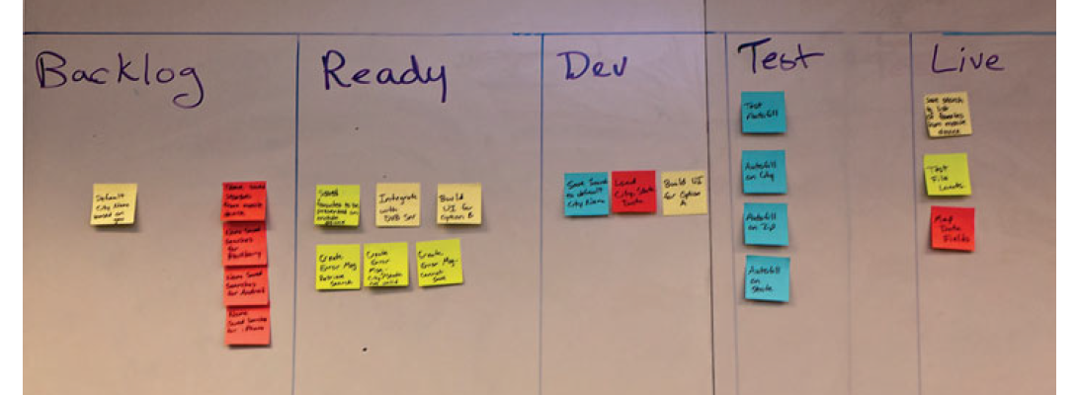
Product Backlog (Scrum and XP)
Where the product backlog is housed will vary from company to company.
Some firms, typically with smaller teams that are all colocated, may have a physical backlog with sticky notes hanging on the wall in priority order.
As collaboration between the business, product owner, and development team affects the priority, the sticky notes are simply rearranged.

Slide 6
Prioritization of Stories
As the P in the DEEP acronym, product backlog requirements/stories must be prioritized.
There are a number of tools and methods to assist with this activity.

Slide 7
Prioritization Based on Value
Targets such as increased revenue, decreased costs, and improved customer service can be the high-level objectives, but now we dive a bit deeper into the value equation.
If your competitors have a distinct advantage over you, then there are real penalties for not offering a competitive feature set.
If our weather app offers weather only in the United States but many of our executive business travelers are traveling to the UK and Mexico and our competitor offers those locations, we may risk losing customers.
Sometimes value is driven by proactively going after new markets and new opportunities.
Other times, value is derived from a more defensive or reactive posture when we are simply matching the features of our competitors.

Slide 8
Prioritization Based on Value
Value must also be supported by a positive return on investment (ROI), so the cost to deliver a desired feature must be considered.
If there is no way to recoup your investment because the cost of delivering the feature is so high, then the value deteriorates and the feature should be deprioritized.
  For example, data format for weather information in Iceland is not compatible with our application and would require a significant amount of code to convert it to a usable format.
  The cost of the data conversion compared with the revenue potential for adding Iceland data reveals that this would not be a wise undertaking and would cost far more than it is worth.
  Therefore, a user story requesting Iceland data should be removed from the backlog with the explanation for the decision.

Slide 9
Prioritization Based on Value
Lastly, there is a consideration of the risks associated with the feature development:
If this feature might jeopardize the stability of the application, then its value is diminished.
You can see that value is not a simple equation and that many factors—revenue, cost, risk, and penalties—must be considered.

Slide 10
MoSCoW
Another method of prioritization is the MoSCoW method favored by Dynamic Systems Development Method.
Must have: All features classified in this group must be implemented, and if they are not delivered, the system would simply not work.
Should have: Features of this priority are important but can be omitted if time or resources constraints appear.
Could have: These features enhance the system with greater functionality, but the timeliness of their delivery is not critical.
Want to have: These features serve only a limited group of users and do not drive the same amount of business value as the preceding items.

Slide 11
MoSCoW
Using Cayman Design as our example, we want to produce our weather related calendars for purchase to create a new revenue stream.
For this product, we have certain priorities with respect to the payment processing portion.
Must have: Ability to accept MasterCard and Visa
Should have: Add American Express and Discover
Could have: Add ACH payments for transactions directly through banking institutions
Want to have: Add gift cards

Slide 12
MoSCoW
As you can see, if we cannot accept MasterCard and Visa, then our offering is not viable; therefore, that requirement is a “must have.”
Adding American Express and Discover is important to our success, so they should be added as quickly as time allows; hence they fall into the “should have” category.
Accepting ACH payments will broaden the appeal of our product but it does not have to be delivered early in the project, so that is a “could have.”
Adding gift cards will serve only a limited audience, so that would fall into the “want to have” category.

Slide 13
Kano Model
The Kano model was introduced in 1984 by Noriaki Kano and was created to help companies learn how to build better products to “delight” the customers.
The model assists with the prioritization process because it breaks down features into three categories.
The first is basic needs, which are sometimes referred to as satisfiers/dissatisfiers.
These are the features that must be there for the product to work, in the eyes of the customer: The functionality is expected, and if it is not included, it causes great dissatisfaction.
After a consumer’s basic needs are met, then there are performance needs, which add necessary functionality to enhance the user experience.
The final category, which results in true product differentiation, consists of features that delight or excite users, and they are an unexpected bonus from the consumer’s viewpoint.

Slide 14
Kano Model
The challenge when it comes to prioritization is to focus on enough of the basic needs, performance needs, and delighters to deliver a compelling product to the marketplace.
If you have a product with only delighters but no basic needs, then you might have something really innovative that does not work.
Conversely, if you have something that satisfies every basic need but does not delight, then customers may not be compelled to buy it because it does not offer anything special or different from the competition.

Slide 15
Kano Model
Another aspect of the Kano model that is critical to understand is the evolution of the feature categorization:
Over time, delighters will become performance needs, and performance needs will become basic needs.
To illustrate this concept, think of the first iPad that you experienced. It had a number of features that delighted:
The touchscreen with the swiping capabilities was awe inspiring when first encountered, but now if we see a tablet that is not a touchscreen, it is completely dissatisfying.
The delighters have become basic needs as the competition has evolved and the technology has advanced.
Therefore, companies must continue to prioritize delighter features if they want to remain innovative.

Slide 16
Estimating
In addition to effective prioritization, grooming and planning sessions require sound estimates for how long the work is likely to take.
There are a number of different ways to come up with the estimates, just as there are many different ways to prioritize the feature requests.

Slide 17
Level of Effort (LOE) or T-Shirt Sizing
Perhaps the least precise but easiest method of estimating goes by one of the following names: “T-shirt size,” “level of effort” (LOE), or “small, medium, large.”
The last title is the most descriptive because the development team just estimates each story as small, medium, or large; teams may add extra-small and extra-large, depending on what they have decided as their measure.
The advantages of this approach are that it is very simple and can be done quickly; the disadvantages include a lack of precision and an inability to add up several stories into a meaningful measure.

Slide 18
Ideal Time (Days or Hours)
In this form of estimating, the developer determines the amount of time that a task would take under ideal circumstances—meaning no interruptions, no meetings, and no phone calls—and that is set as the ideal time.
This is an easier metric for developers to assign than actual clock time because it is difficult for them to factor in all of the possible interruptions that might occur.
Each organization will have some factor that is applied to convert ideal time to clock time; a ratio of 2 to 1 is fairly common, meaning that within every hour, 40 minutes are spent on concentrated work, with the other 20 minutes consumed by interruptions or breaks

Slide 19
Story Points
In Scrum, many teams use the concept of “story points,” which are an arbitrary measure that allows the teams to understand the size of the effort without the potentially binding expectations that come with hours.

Slide 20
Fibonacci Sequence
When estimating in story points, many teams use the Fibonacci sequence, a mathematical tool defined in the thirteenth century for rational approximations.
The sequence is the sum of the prior two numbers: 1, 2, 3, 5, 8, 13, 21;
as you can see, 1 + 2 = 3, 2 + 3 = 5, 3 + 5 = 8, and so on.
The Fibonacci sequence is helpful for Agile estimating because as the points get higher, the degree of uncertainty is increasing.
Also, many teams replace the 21 with 20 and add 40 and 100; the idea is that if a story is estimated at greater than 13 story points, there is a good chance that it is still an epic and needs to be broken down.
The difference between a 20, 40, or 100 is just a sense for the size of the epic.

Slide 21
Fibonacci Sequence
One additional thing to keep in mind is that unlike hours, which have a fixed and commonly understood definition, story points are more abstract and negotiable.
One team may assign 3 points to a story where that same story on another team would have been a 2 or a 5.
As long as everyone on the team agrees to the size of a story point, then only all of the estimating will be coherent.

Slide 22
Team Participation
How does an Agile team actually execute on the estimation process? In all instances, we are looking for participation from the developers and testers because we want to benefit from the wisdom of self-organizing teams.
Outlined next are several strategies that teams have used to come to consensus on estimation.

Slide 23
Planning Poker
Having the development team participate in the activity of estimating can have distinct advantages over asking a single developer to size a feature.
If the team is using story points, as just outlined, one of the fun and effective ways to increase engagement is through a game called “planning poker.”
Each team member is given a set of number cards with the modified Fibonacci sequence—1, 2, 3, 5, 8, 13, 20, 40, 100.
Sometimes teams use a regular deck of cards, using aces for 1 and the face cards for the larger numbers.

Slide 24
Planning Poker
After the product owner and the team have discussed the user story in detail and everyone believes they have an adequate understanding, the Scrum master or coach will call for each team member to lay down the card representing the number of story points that he or she assigns to this user story.
Many Scrum masters ask all team members to “throw” at the same time so that no one can be influenced by their teammates.
In addition to an estimated size, we are looking to see if there is a discrepancy.
If a user story is discussed and one team member throws a 2 but another throws a 13, then there is a difference that needs to be discussed.

Slide 25
Planning Poker
It does not mean that one person is right and the other is wrong; this actually identifies a lack of common understanding as it relates to the user story.
Just like all of the other opportunities within Agile for collaboration and discussion, this discrepancy should be explored.
Why did the developer who threw the 13 think that this task was so big?
Is there a point of interconnection that the other developer (who threw the 2) was not thinking of?
Did they just understand the request differently?
Or has the low estimator done something like this before, so he or she is very confident in that assessment?

Slide 26
Crystal Family
The Crystal Family software methodology calls for three distinct phases of estimates.
Early on, in the proposal stage, the developers review the initial requirements and work breakdown to provide an estimate of the work.
The project then moves into the exploration phase, where many more details are gathered and as a result of the new information, the estimates are refined.
Finally, the team moves into the planning meeting, where each element is broken down into a discrete task and assigned to a developer.
The developer has the opportunity to update the estimate at that time.

Slide 27
Extreme Programming (XP)
Within XP, it is critical that the developers are the ones making the estimates and no one else; they are also the only ones who can make changes to estimates.
The goal is to instill a degree of responsibility or ownership of the estimates to the developers.
The XP process also provides a feedback loop for the actual time required, so developers can continue to improve their estimates over time

Slide 28
Lean
Within Lean, since the concept of reducing waste is so important, it favors waiting until the feature is nearly ready to be worked on before completing an estimation.
If you have a full feature list that contains requests with the associated details and estimates that are so far down in the queue that it is highly unlikely they will ever be completed, you run the risk of creating inaccurate expectations, and you are increasing the amount of waste in the process.
“Investing time estimating projects that will never get done is also a waste”

Slide 29
Scrum: Product Backlog Grooming
The activities of prioritization and estimation often take place in a session called product backlog grooming.
This is typically a meeting between the product owner and the Scrum master/coach and may include the entire development team.
The grooming session is also used to clarify and improve on the user stories; this could include identifying and breaking down requirements that are too big (epics), improving poorly written stories, and adding acceptance criteria.
Once the participants have a clear understanding of the features/stories, they can discuss the prioritization of those stories and add the estimates.

Slide 30
Scrum: Product Backlog Grooming
The goal of the grooming session is to leave the meeting with good, solid user stories that are prioritized, discussed, well understood, negotiated, and agreed upon so that the next few action items can take place to ensure a successful sprint.
The product owner is responsible for leading the grooming session.
Additional Inputs
Once the backlog grooming is complete and the team understands the highest priority user stories in sufficient detail, the next meeting or ceremony in the Scrum methodology is Sprint planning.
Before we can effectively execute on that meeting, several additional data points must be collected and understood.

Slide 31
Team Velocity
Within Agile, as teams spend time together and work through a few sprints, they start to get a sense for their “velocity”: This is the amount of work that the team can usually deliver within the time frame of a sprint or iteration and can be used as a predictor for future iterations.
Story points are the most common units of measure for velocity, though hours could be used if the team was estimating in hours.
It would be challenging to calculate velocity for a team estimating in t-shirt sizes (or small/medium/large) because the estimates cannot be mathematically summed.

Slide 32
Team Velocity
When a team first comes together, it is difficult to estimate their velocity because they have not yet experienced an iteration as a team.
The first few iterations are usually more guesswork than precision, and that is fine because it provides the opportunity to inspect and adapt.
Once the team is established and finds their rhythm, velocity is a great tool to use when establishing their commitment for future iterations.
Nevertheless, a few factors can disrupt velocity.
  team members are not dedicated to the team full-time
  team members change frequently
  modifying the length of the sprint and so on.

Slide 33
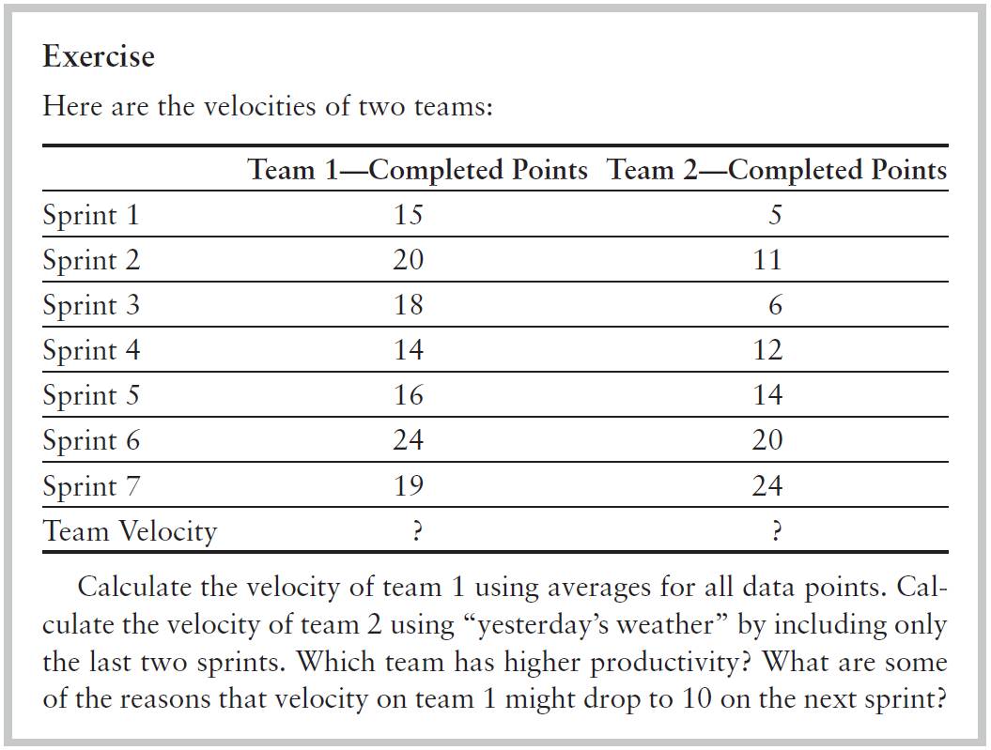
Team Velocity

Slide 34
Definition of “Done”
Within several of the Agile methodologies, including Scrum, there is an element called the definition of “done.”
This is a meaningful conversation that the development teams, product owner, and stakeholders need to have to ensure a common understanding of completion.
When different people have a different definition of done, expectations will not be met and dissatisfaction can result.
Every new team should dedicate time to discussing and agreeing on their definition of done, which may or may not include elements such as code that is checked in and integrated and has automated tests.
When the definition of done is clear and well understood, then we ensure that the conclusion of every sprint will meet everyone’s expectations.

Slide 35
Definition of “Done”
Extreme Programming handles the definition of done slightly differently:
When a task is completed, it is crossed off of the board. To ensure that done means done, in XP, only the customer (not the developer) can cross off a task

Slide 36
Scrum: Sprint Planning
In Scrum, once we have the necessary inputs, we are ready for the Sprint planning meeting. In this meeting, we are going to decide exactly what we are going to work on during the sprint and we are going to plan for it—hence the name: Sprint planning.
Inputs
There are a number of inputs to the Sprint planning meeting, such as the following:
  Groomed and prioritized backlog
  Estimates for the highest-priority stories
  The velocity of the team
  Definition of done
  The schedule of the sprint—are there vacation days or a company holiday that will affect the amount of work we can commit to?
  Other inputs—are team members getting new monitors, is there an All- Hands meeting that everyone is required to attend?

Slide 37
Planning Session
The Sprint planning meeting has two distinct objectives.
First, we want to make sure that everyone on the team has a complete understanding of the user stories.
Team members may not all have attended the backlog grooming session, so it is important that everyone have the opportunity to ask questions and gain a clear understanding of the top-priority stories.
The second objective is to allow the team to break the work down into individual tasks and determine who will own each piece of work.

Slide 38
Planning Session
Let’s walk through this process step-by-step.
1. Once we understand the user stories, the team will decide how many stories can be committed to during this sprint. This is the sprint goal.
2. The team then breaks the user stories down into individual tasks.
3. Each team member selects the tasks that he or she is willing to own and complete.
4. The team member then estimates—in hours—how long it will take to complete each task.

Slide 39
Planning Session
Output
There are two primary outputs from the Sprint planning meeting.
First is the Sprint goal, the user stories that are committed to for this sprint.
Second is the Sprint backlog, which is the list of tasks and owners.
The Sprint backlog is the team’s “to do” list for the sprint.

Slide 40
Extreme Programming: XP Planning Game
XP has a ritual similar to the Scrum backlog grooming session and the Sprint planning meeting: the planning game.
The planning game also consists of two parts:
release planning, which is most similar to backlog grooming, and
iteration planning, which is most similar to Sprint planning.
Each meeting has three distinct phases—exploration, commitment, and steering.

Slide 41
Extreme Programming: XP Planning Game
It is important to note the participants in the different parts of the planning game.
“Because customers have the most information about value—they’re most qualified to say what is important—they prioritize.
Because programmers have the most information about costs—they’re most qualified to say how long it will take to implement a story—they estimate.
Neither group creates the plan unilaterally.
Instead, both groups come together, each with their areas of expertise, and play the planning game”

Slide 42
Triple Constraints
There is a long-held principle within the project management discipline that projects are made up of three variables: schedule/time, cost/resources, and scope/quality.
The theory is that you cannot adjust one without affecting the other two.
  If you shorten the schedule and say that a release is due one month earlier than planned, then you will also need to add resources or reduce the scope in order to meet the new desired date.
  Likewise, if you remove resources from a project, you will need to either extend the time frame to push out the delivery date or reduce the scope.
  Finally, if you add to the scope, then you will need to either extend the time frame or add resources.

Slide 43
Triple Constraints
Agile looks at the theory of triple constraints slightly differently.
First, there is a school of thought that scope and quality are, in fact, two very different things:
A team could deliver the prescribed scope at lesser quality, or it could maintain acceptable quality standards with a reduced scope.
As Wells (1999) explains, “The base philosophy of release planning is that a project may be quantified by four variables; scope, resources, time, and quality.
Scope is how much is to be done.
Resources are how many people are available.
Time is when the project or release will be done.
And quality is how good the software will be and how well tested it will be.
No one can control all [four] variables.
When you change one, you inadvertently cause another to change in response.”

Slide 44
Triple Constraints
Another way to look at this in an Agile environment is to suggest that resources and time are fixed.
The team size is five to nine people, so that cannot change.
The date is fixed by the duration of the sprint, in many cases two weeks.
Therefore, scope must be flexible to be able to be designed, coded, and tested within the confines of the sprint.
By managing the size and priority of the stories in the backlog, you are effectively managing the scope while the time and resources are fixed.

